Slide 1

Support Ticket Classifier ChatBot with RAG
Transform your support operations with intelligent ticket classification powered by Retrieval-Augmented Generation technology
By Arun Srinivasan

Slide 2
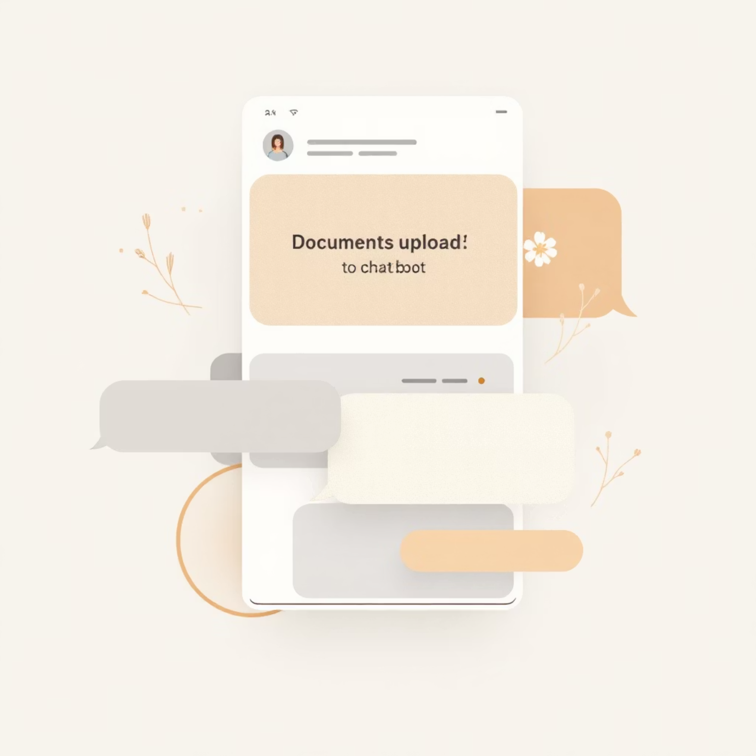



Intelligent Chatbot Interface
Multi-Format Processing
Upload PDFs and CSV files seamlessly with automatic text encoding detection and format optimization
Real-Time Conversation
Engage with your documents through natural language queries and get instant, context-aware responses
Multi-format Support
Context-Aware AI
Multi-Language
PDF, CSV, and complex data structures
Understands content and conversation history
Handles various encodings and formats

Slide 3






Advanced Analytics Dashboard
Priority Analysis
Status Tracking
Visualize ticket distribution across Critical, High, Medium, and Low priority levels with interactive charts
Monitor real-time ticket status: Open, Closed, Pending Customer Response with distribution metrics
Type Classification
Satisfaction Metrics
Analyze ticket types including Technical Issues, Billing, Refunds, and Account Management
Track customer satisfaction ratings, identify trends, and measure service quality over time
Resolution Time
Interactive Visuals
Histograms and box plots reveal resolution patterns, bottlenecks, and performance benchmarks
Bar charts, pie charts, heatmaps, and correlation matrices for deep insights

Slide 4

RAG-Powered Document Processing
01
Vector Embeddings
HuggingFace BGE embeddings enable semantic search and context understanding
02
Qdrant Vector Database
Lightning-fast storage and retrieval of document chunks with optimized indexing
03
Smart Text Splitting
Recursive character-based splitting ensures optimal chunk sizes for accurate retrieval
04
Complex CSV Handling
Processes multi-line CSV files with embedded line breaks and special characters

Slide 5





Modern Tech Stack
Groq LLM Integration
Streamlit UI
Llama-3.3-70B-Versatile model delivers blazing-fast inference with exceptional accuracy for support ticket analysis
Beautiful, responsive web interface with real-time updates and intuitive navigation for seamless user experience
LangChain Framework
Data Science Suite
Modular AI application development with composable components for flexible, maintainable architecture
Pandas for data manipulation, Matplotlib and Seaborn for statistical visualization and insights generation

Slide 6




System Architecture
Streamlit UI Layer
Chatbot Manager
Groq LLM API
Responsive frontend interface for document upload and chat interactions
RAG-powered processing engine coordinates between UI and AI services
High-performance language model generates intelligent responses
Vector Database
Analytics Engine
Qdrant powers semantic search with efficient vector storage and retrieval for document chunks
Helpdesk Analytics Dashboard processes ticket data for actionable insights and visualizations

Slide 7

Project Structure
📄 new.py
Main Streamlit application orchestrating the entire system
🤖 chatbot.py
Chatbot manager with RAG integration and conversation handling
📊 helpdesk_analytics.py
Analytics and visualization engine for ticket insights
🔧 vectors.py
Vector embeddings and document processing utilities
Complete package includes: requirements.txt for dependencies, Streamlit configuration, MIT License, and comprehensive documentation

